Slide 1
Game UiUx Research
Stephanie Ho Yen Yuin
2100364E
P02

Slide 2
Aim of Research
What frustrations do players face when playing a game they like?
What motivates a player to play a game?
Survey Link: https://forms.gle/yWQDMq7erFdAes7k7

Slide 3
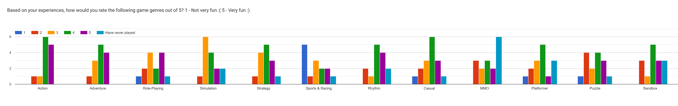
Game Genres

Slide 4
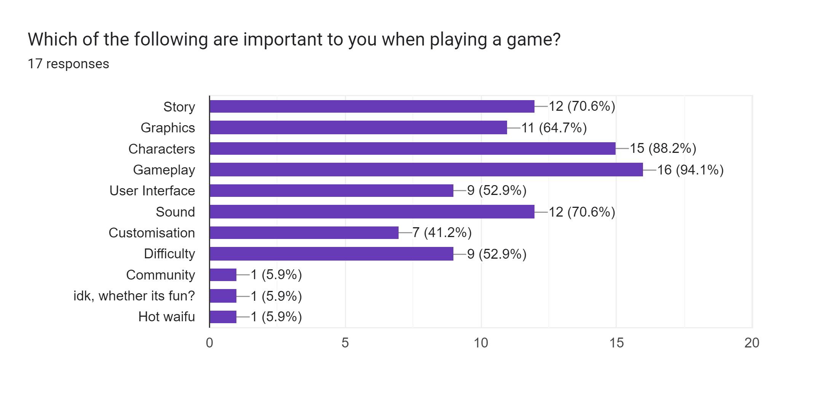
Player Motivations

Slide 5
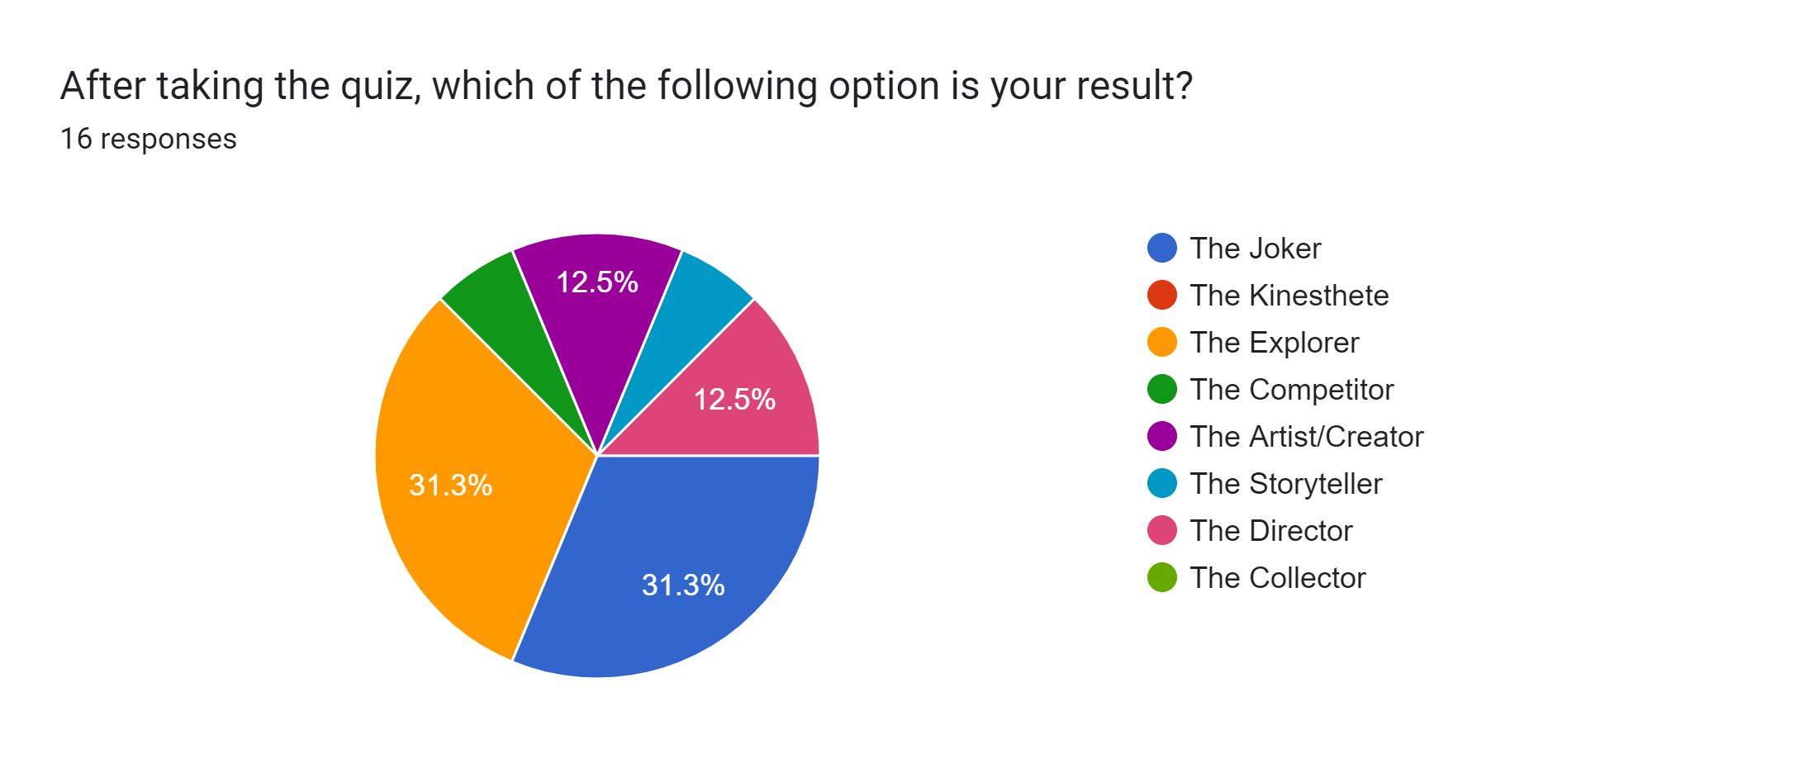
Player Personalities

Slide 6
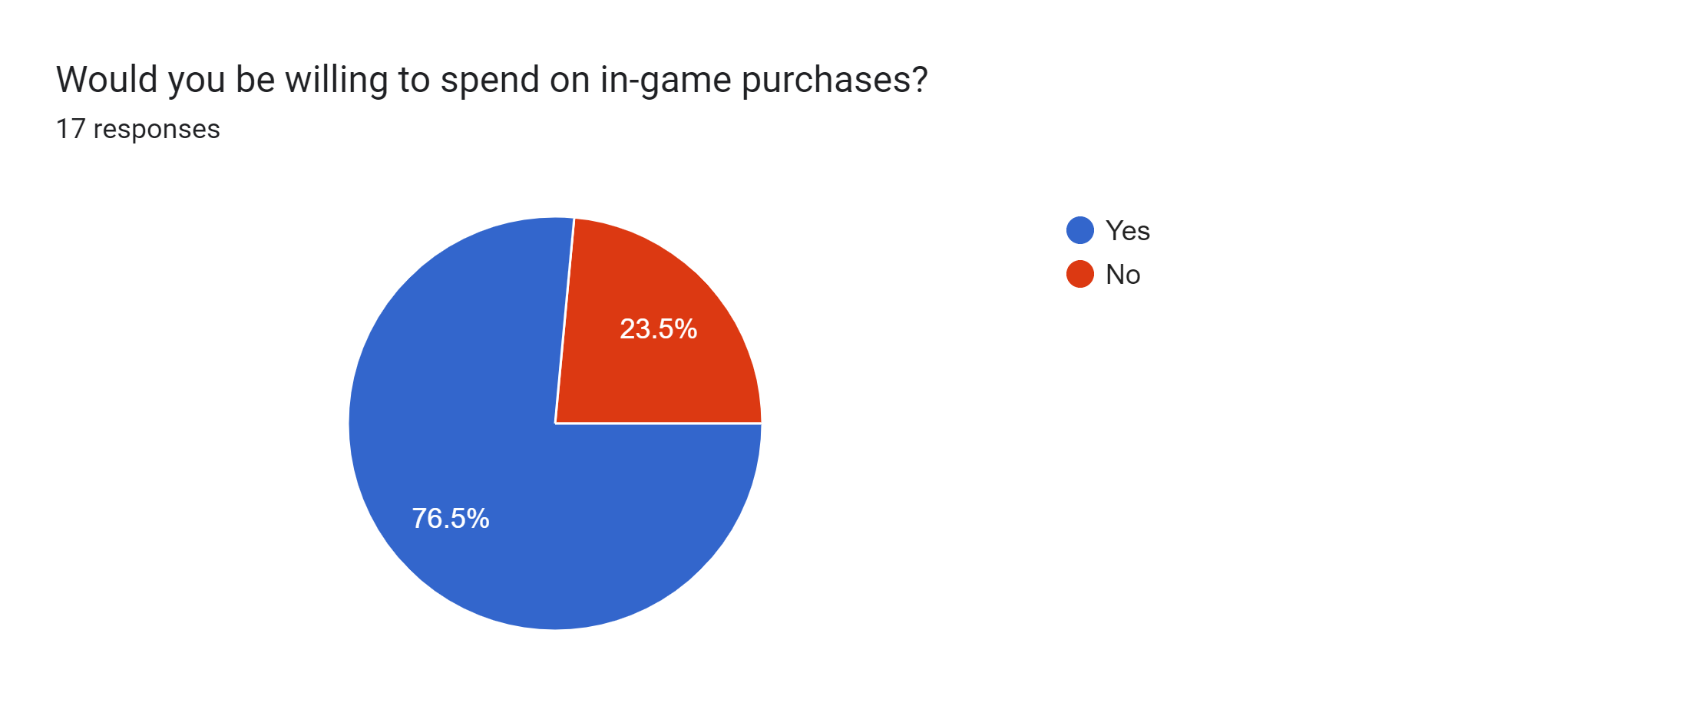
Game Content

Slide 7
Interview 1 [The Storyteller]
https://youtu.be/-vqnOJaCajE

Slide 8
Interview 2 [The Joker]
https://youtu.be/T1Ny-fTXX7g

Slide 9
Interview 3 [The Joker]
https://youtu.be/MOGWPAw-Lcw

Slide 10
Interview 4 [The Artist/Creator]
https://youtu.be/n3pCchFW7kI

Slide 11
Interview 5 [The Artist/Creator]
https://youtu.be/nhNj5r8r5Xs

Slide 12
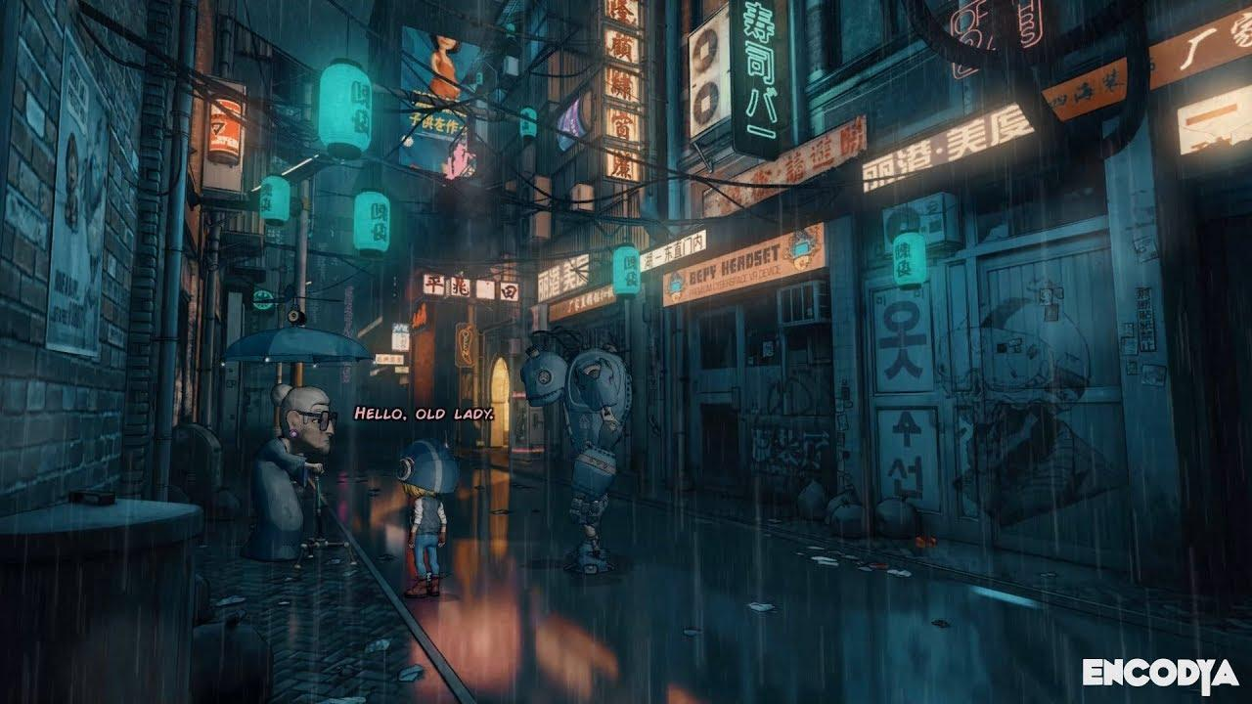
Key Findings & Potential Solutions
From the survey, majority of the player’s favourite games are Sci-Fi.
Sci-Fi themed action-adventure genre.
From the survey, characters are one of the most important to players
Player can equip different soul stones which changes the shell of the character, taking on a new lifeform with different gameplays.
From the survey, most of them are explorers or jokers.
Explorers: Focus on world building, add hidden areas.
Jokers: Have physical interactions with other characters (NPCs) in the game. Allows player to have more fun with the environment.
All participants’ favourite games are on PC, except for User 2.
However, one of user 2’s frustration was because his favourite game was not on PC.
In the survey, overall most popular platform is PC.
Conclusion: Most popular platform is PC.
Those willing to spend on in-game purchases will spend on:
Cosmetics, characters (gacha), downloadable contents (DLC).

